Slide 1

Social Institution Of Pakistan
BY champion group

Slide 2

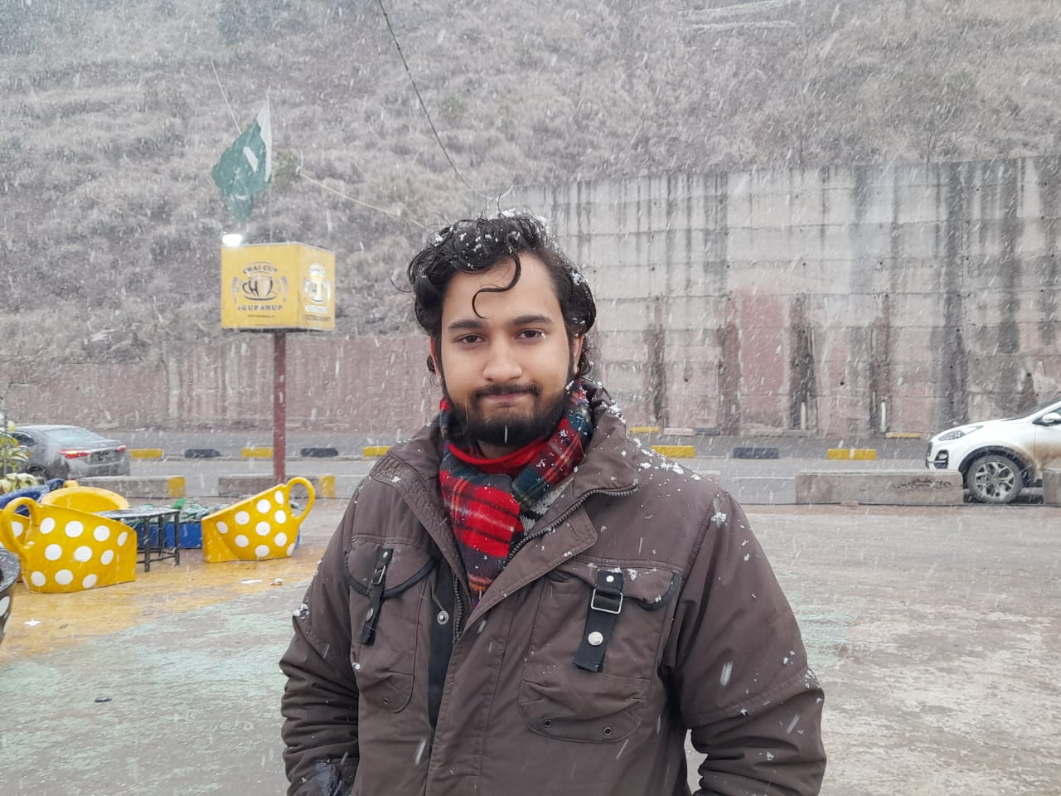
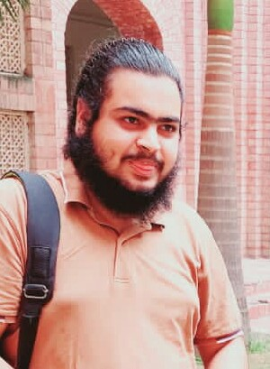
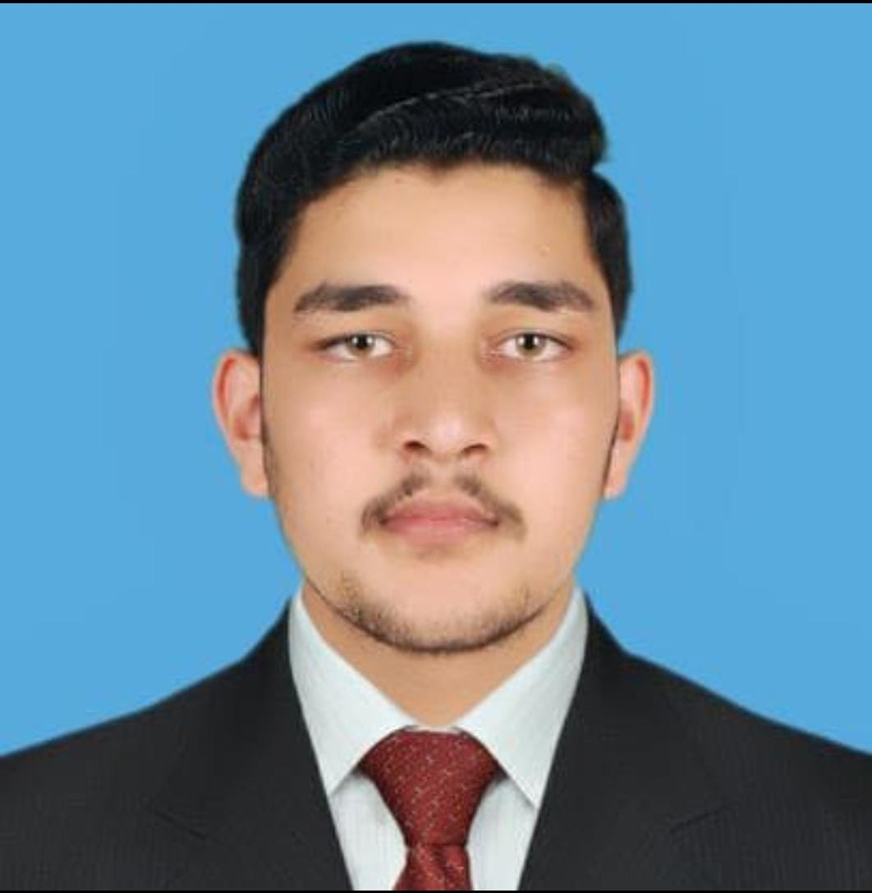
Team Member
Kashif Mehmood
4166-FBAS/BSCS4-F19
Saif Ali Khan
4194-FBAS/BSCS4-F19
Hamza Azhar
4172-FBAS/BSCS4-F19
M. Sufyan Abbasi
4203-FBAS/BSCS4-F19

Slide 3
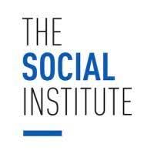

Intro. Of Social Institution
Group of people who together for common purpose.
These are the structure of society which fulfils the needs of society.
Social institution operate, maintain and regulate in society.
Certain Rules and Roles.
Exist in every society.

Slide 4
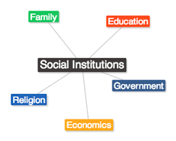
Major Social Institution Of Pakistan
Family
Education
Economic
Government
Religion

Slide 5

Family
Primary and universal social institution .
Group of people which is consist of husband, wife and children.
BASIC unit Marriage.
Group of people united by marriage, Blood and adaption.
Every member in family will perform

Slide 6
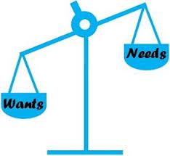
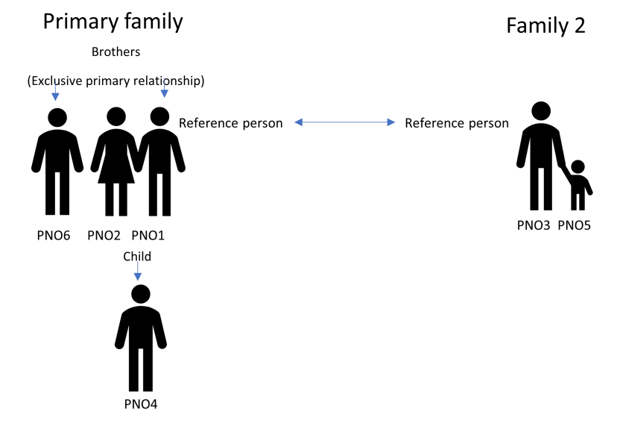
Function Of Family
Primary or Essential Function
Stable satisfaction of biological needs and survival of human race.
Reproduction and rearing of children.
cultural transmission.
Social identity.
Socialization.
Secondary or Non-essential Function
Fulfil economic needs
Education
Tell us about religion.

Slide 7

Educational Institution
An education system is a place where people of different ages gain an education.
Understanding the role of education in shaping
society.
Overview of the educational system in
Pakistan

Slide 8
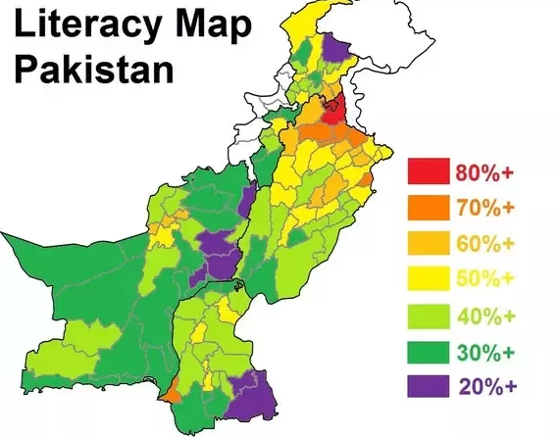
History of education in Pakistan
Literacy 2022 : Total 72
Male : 81.22% Female : 54.71%
Enrollment : 32.33% of population
Primary : 67.57%
Secondary : 43.82%
Post Secondary : 14.85%

Slide 9
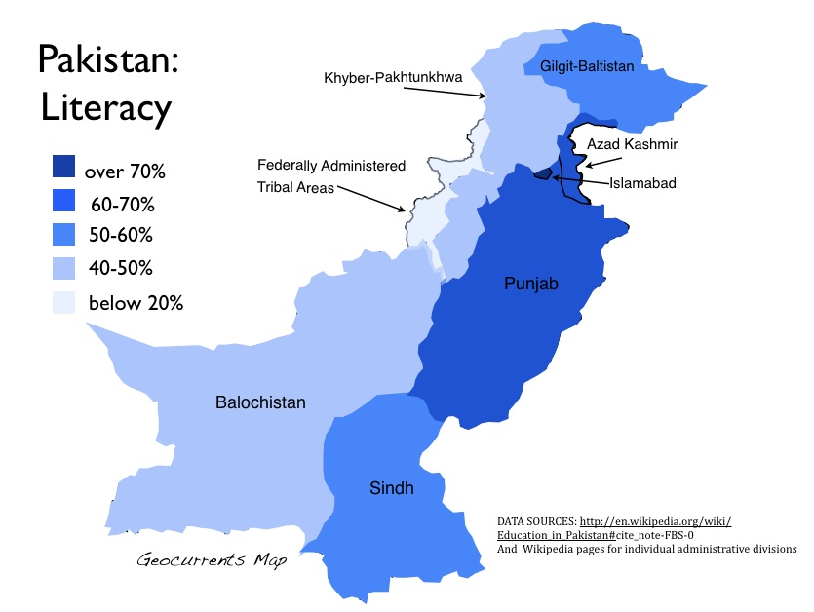
History of education in Pakistan
The literacy rate ranges from 82% in Islamabad to 23% in the Torghar District
Literacy rates vary by gender and region
In tribal areas female literacy is 9.5%, while Azad Kashmir has a literacy rate of 74%.
Pakistan produces about 445,000 university graduates and 25,000–30,000 computer science graduates per year.
Despite these statistics, Pakistan still has low literacy rate And Pakistan also has the second largest out of school population (22.8 million children) after Nigeria.

Slide 10
Functions of Educational Institutes
01
02
Transmitting knowledge and skills
Promoting socialization and cultural values
It’s a Platform, gives Structured environment
Interaction with peers, social activities, celebrating cultural events
03
04
Facilitating social
mobility
Fostering critical thinking and problem-solving abilities
Socio-economic situation, serve as catalyst, upward mobility
Aims to develop, Analyse and Question

Slide 11
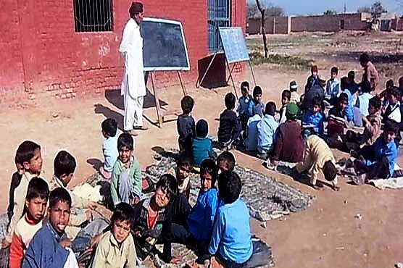
Challenges Faced by Educational Institutions
01
02
Access and equity
issues
Quality of
education
Pakistan Education Statistics, unequal distribution, limited infrastructure, socio-economic factors
Global Competitiveness Report, trained teachers, out-dated curriculum,
03
04
Gender
disparity
Lack of resources and infrastructure
Pakistan Social and Living Standards, barriers, women specific schools
Annual Status of Education Report, rural areas, economic situation

Slide 12

Economic Institute
Economy play import role in country.
Well Economy increase the importance of country in all over the world.
Production, distribution and consumption of good and services.
Regulate the economic needs of society.
Two Economic System in world
Capitalism (private no involve government)
Socialism (production are owned in common, typically controlled by the state or government.).

Slide 13
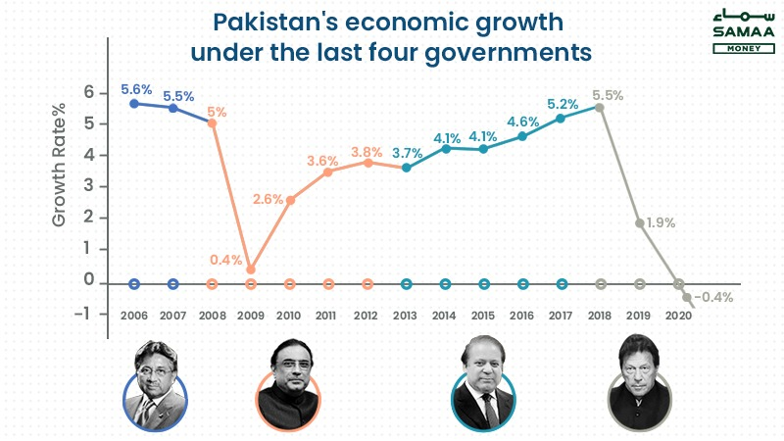
Introduction to Economy of Pakistan
Economy of Pakistan is the 47th largest in the world in nominal terms .
27th largest in the world in nominal terms of purchasing power parity (PPP).
Pakistan has a semi-industrialized economy, which food chemicals, textiles, encompasses mainly processing, agriculture and other industries Growth poles of Pakistan's economy are situated along the Indus River; diversified economies of Karachi and Punjab's urban centres coexist with lesser developed areas in other parts of the country.

Slide 14
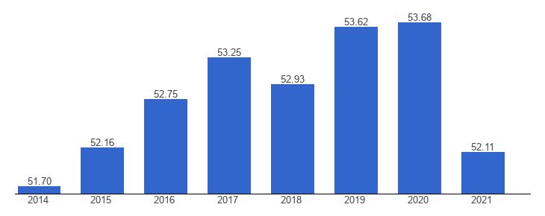
Economic history of Pakistan
Pakistan gained independence in 1947 from UK, since economic growth rate Pakistan's average independence has been higher than the average growth rate of the world economy during the period Average annual real GDP growth rates were 6.8% in the1960s, 4.8% in the 1970s, and 6.5% in the 1980sAverage annual growth fell to 4.6% in the 1990s with significantly lower growth in the second half of that decade.
1947-1950 (Agriculture share: 53.2%, Change: +0.2%)
1950-1958(Agricultural growth: 1.9%Manufacturing growth: 7.7%Economic Growth: 3.1%)
1958-1969 (GDP growth: 6.7%Manufacturing growth: 8.51%).
1969-1977(The national savings to GDP ratio rose to 16%.Agricultural growth: 5.4%LSM growth: 8.8%Average GDP growth: 6.3%)

Slide 15

Economic history of Pakistan
1988-1999(The GDP growth saw its worst increase of only 1.7% in 1996 and the second-worst inflation of 14.5% in 1995.Poverty rose, and foreign debt tripled. Pakistan’s nuclear program drew further sanctions and left the country on brink of bankruptcy .Agricultural growth: 4.4%LSM growth: 4.8%GDP growth: 4.05%).
1999-2008(Growth rates saw increases until 2004-2005’s peak of 8.6%.Debt to GDP ratio saw a decrease from 100% to 55%.Foreign exchange reserves increased by $9 billion. Agricultural growth: 5.4%LSM growth: 8.8%Average GDP growth: 6.3%).
2008-2013(Economic growth slowed down to 4.09%, and the yearly growth fell to 2%.Agricultural growth: 2%LSM growth: 4.4%Average growth rate: 4%).
2013-2018(Average GDP growth rate: 5%)

Slide 16

Economic history of Pakistan
2018-2020(GDP growth rate fell to a historic low of 0.99% in 2019, much below the 5.55% in 2017.)
Changes in GDP proportions 1947-2019
Agriculture 53% 22.04%
Industry 9.6% 18.34%
Services 37.2% 53.86%
Change – Percentage
Negative -30.96% (Minus)
Positive +8.74% (Plus)
Positive +16.66% (Plus

Slide 17

Political Or Government Institute
Policy maker.
Implement.
Type of government in all over world
Monarchy (Saudi Arab)
Democracy (Pakistan)
Authoritarianism (Zimbabwe)
Totalitarianism (soviet union).

Slide 18

Political Or Government Institute
Types of Government Structure
Legislative Branch (Parliament).
Executive Branch.
Judicial Branch

Slide 19
Legislative Branch Parliament (Senate)
In 1947 to 1973. The Country had a unicameral system of legislature. ( National Assembly)
Under the 1973 Constitution, Pakistan adopted bicameral system at the centre, called “The Parliament”, composing the President, the National Assembly and The Senate.. (Senate & National Assembly ).
Four members i.e. two on general seats, one technocrat including Aalim and one woman are elected from the Federal Capital whereas eight members are elected from the Federally Administrated Tribal Areas (FATA) in such manner as the President may, by order prescribe.
Senate. have 100 seats and its duration is 6 year. Elected
FATA : 4 seats Islamabad : 4 seats Punjab : 23 seats
Sindh :23 seats KPK :23 seats Baluchistan : 23seats
In 2024 will be 96 seats in Senate. (FATA will be included in KPK.

Slide 20
Legislative Branch Parliament (National Assembly)
The Speaker of the House is the presiding officer of the National Assembly. The speaker is assisted by the Deputy Speaker. Both officers are elected from within the ranks of the National Assembly and, by current convention, are usually members of the majority party.
National Assembly Members are 342.
Duration 5 year.
272 directly elect 272 MNA’s. members
Remaining member 70..reserved 60 seats for women and 10 for minorities. (Hindus or Christion’s.)
Population based.. 1st Punjab 2nd Sindh 3rd KPK 4th Baluchistan.
The place where we discuss the issues and problems to resolve them.

Slide 21
Executive Branch
Executive branch which is used to implement the law which were passed in parliament.
Prime Minister. (Chief executive of Pakistan., head of governor)
President.(head of state) before passing Eighteenth Amendment 2010 president have more rights. For example can dissolve assembly.
After 2010 Now Prime minister and parliament can dissolve assemblies .

Slide 22
Executive Branch
Secretaries
Pakistan Army forces
Ambassadors
Chief minister.

Slide 23
Judicial Branch
Supreme Court of Pakistan.
The highest court of Pakistan. Its Chief justice in current is
Federal Shariat Court.
Five High Court in Pakistan.
Every Province have high Court. For example (Punjab, Sindh, Baluchistan, KPK).
Fifth high Court in Islamabad.

Slide 24
Intro. Religion
Satisfy the spiritual needs of human needs.
It promotes social solidarity, social cohesion and social control.
It affects society as well as individual.
It help us controlling our emotions like anger, fear etc

Slide 25
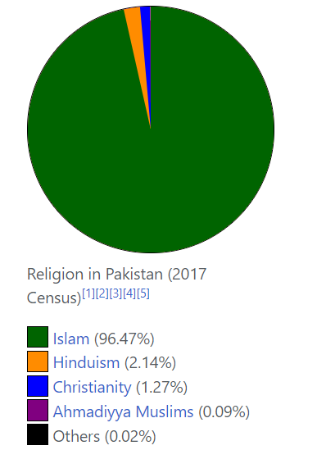
Religion in Pakistan
The official religion of Pakistan is Islam, as enshrined by Article 2 of the Constitution, and is practised by approximately 96.47% of the country's population. The remaining less than 4% practice Hinduism, Christianity, Ahmadiyya Muslims, Sikhism and other religions.

Slide 26
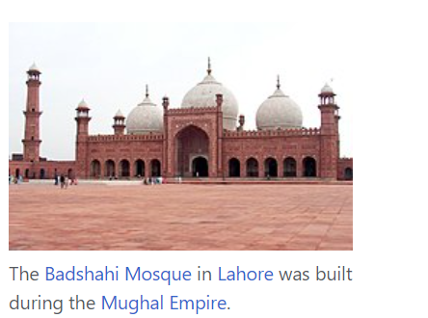
Religion in Pakistan
Islam: The religion of the Muslims, a monotheistic faith regarded as revealed through Muhammad as the Prophet of Allah.
Worship: The Arabic word 'ibadat (sing. 'ibada) which literally means to enslave oneself (to God), when it is used as a religious term, refers to the ordinances of divine worship.

Slide 27
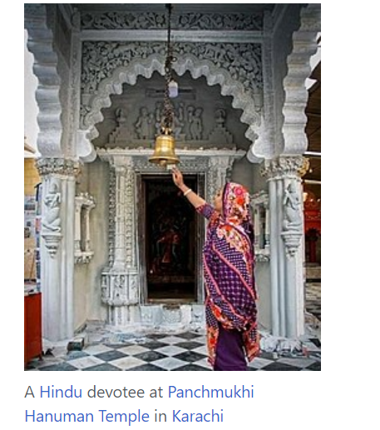
Religion in Pakistan
Hindu: The word Hindu is an exonym. This word Hindu is derived from the Indo-Aryan and Sanskrit word Sindhu, which means "a large body of water", covering "river, ocean". It was used as the name of the Indus River and also referred to its tributaries.
Hindu worship : Hindu worship, known as puja, involves all five senses of touch, taste, smell, sight and hearing, and also what Hindus consider to be the five basic elements: light, fire, earth, air and water. It can be carried out in the home of Hindus before a shrine, or in the Hindu temple, which is known as a mandir.

Slide 28
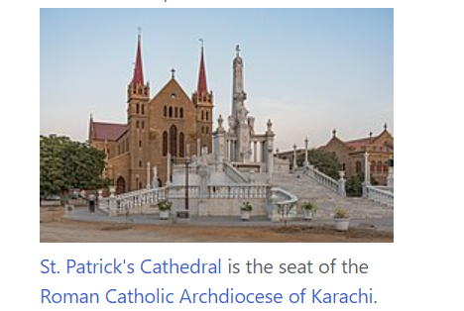
Religion in Pakistan
Christian: a person who believes in Jesus Christ and follows his teachings.
Christian Worship: In Christianity, worship is the act of attributing reverent honour and homage to God. In the New Testament, various words are used to refer to the term worship. One is proskuneo ("to worship") which means to bow down to God or kings.

Slide 29
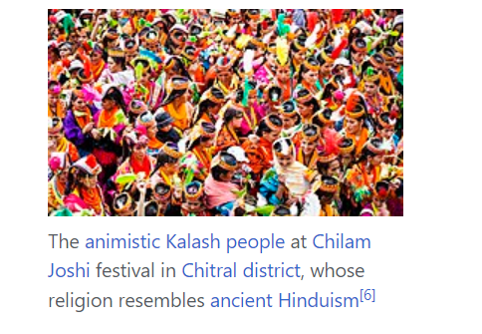
Religion in Pakistan
Animistic kalash people religion: The Kalash people are a small religious and ethnic minority of Pakistan. The Kalash religion is polytheist faith similar to ancient forms of Hinduism and the people offer sacrifices for their gods. Their culture is interlinked with their religion and includes several unique festivals and celebrations.

Slide 30




Conclusion

Slide 31



